Slide 1
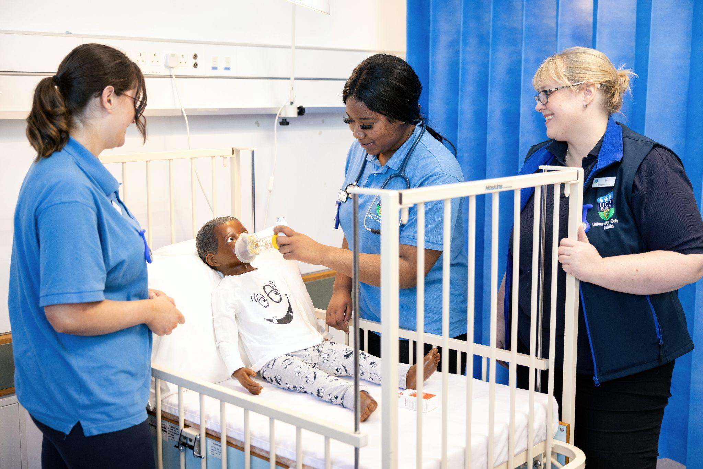
CLINICAL SKILLS

Slide 2



CLINICAL SKILLS
Clinical Skills Laboratories facilitate interactive teaching and learning for Nursing and Midwifery clinical skills. Here students can practice their clinical knowledge and skills in a safe environment, towards gaining competency in nursing and midwifery practice.
There are 6 clinical skills laboratories with a wide catalogue of low-high fidelity nursing manikins and simulators available to assist in the delivery of skills in all strands of nursing, midwifery and healthcare systems. Managed by the Clinical Skills Lab Managers.
It is essential to attend scheduled labs as per your student timetable and adhere to the lab code of behavior.

Slide 3
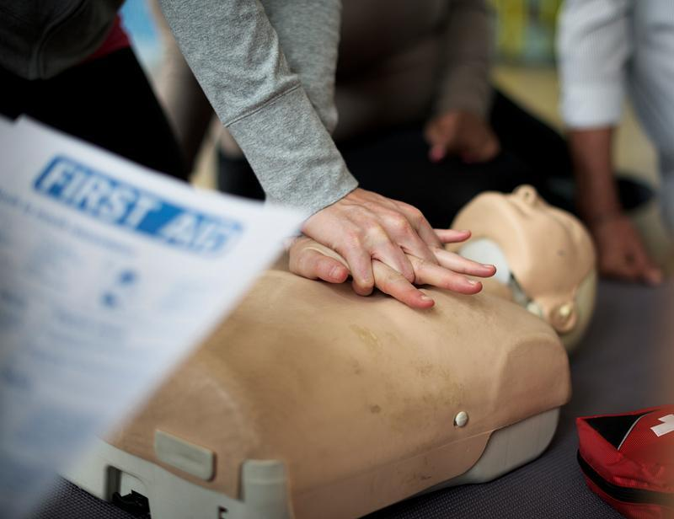
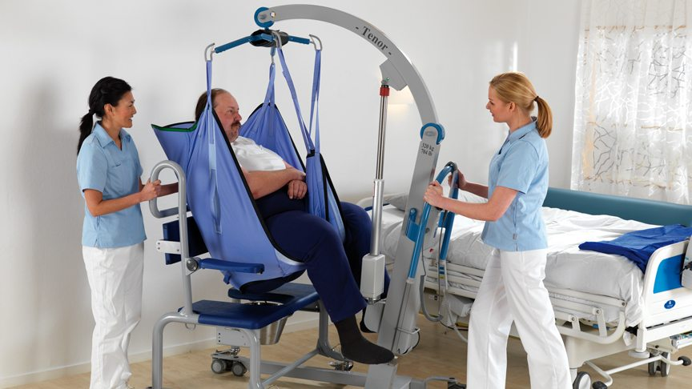
Two MANDATORY PRACTICE PLACEMENT REQUIREMENTS facilitated here in the SNMHS skills labs are: BLS AND Patient Handling
Both appear under NMHS10480 on your timetable
Basic Life Support (BLS HCP) Certification and Patient moving and handling Certification
BLS Certification has 2 components
PART 1: Online Heart Code theory
PART 2: Practical on campus skills training session.
BLS Certification from the Irish Heart Foundation/American Heart Association certificate requires completion of PART 1 online and attendance of PART 2 in person
Patient moving and handling has 2 components
PART 1 Online HSEland Theory
PART 2 Practical on campus skills training session

Slide 4




BLS PART 1 Online Theory
You will be sent an e- mail link to your new student UCD Connect account from First Aid For Life the external training provider to allow you to enroll for the online Heart Code Theory through the Learning Portal. (check your SPAM). You will need a laptop/PC/Tablet or smart phone for the session.
Please activate the link by clicking on it, and then click the “Activate Course” on the page. A pop-up box will appear asking you to sign in or register to activate your license. You must register prior to beginning your course. Please note Fair Processing Notice to consent
You do not have to complete the modules in one sitting; But any incomplete or unsaved modules may not be captured. This online theory course takes approx. 6-8 hours to complete. We recommend that you register and access the programme asap.
Once all modules and components are completed you will have access to an automatically generated completion certificate to download or print. You must have this completed prior to attending in person
TIP…. Start early and complete in advance to troubleshoot any issues in preparation for practical training….

Slide 5






BLS PART 2 Skills training Day
Friday the 17th of October or Friday the 24th of October
Practical BLS skills training is held here on campus in the SNMHS clinical skills labs
Please Check timetable NMHS 10480 in advance for your allocated SNMHS lab location date and time slot.
Please bring the digital or printed certificate generated from Part 1 with you. Failure to do so will mean you may not be permitted to attend the skills session that day.
Wear comfortable appropriate clothing and footwear.
Arrive at least 10 mins before start time to allow instructors to confirm attendance.
On successful full course completion an IHF/AHA certificate will be awarded to you on the day.

Slide 6

Patient Moving & Handling
Combination of online HSEland theory and practical skills in person. You must complete the online HSEland Theory and upload the cert before you attend your practical skills session. In order to attend practical training, you should consult this document, How to Guide for Hseland Enrolment & Certificate Upload.pdf This document provides the link where you can upload the HSEland theory cert.
You have been allocated approx. 2 hours of online time on Friday Sept 19th at one of the following times to complete this: 9.30 or 11.30 or 14.00 or 16.00. Please check NMHS10480 to find your timeslot.

Slide 7
Patient Moving & Handling Practical Skills
Practical sessions-please see timetable for NMHS10480
One Friday only for half a day must be completed
Either Friday 26th September or Friday 3rd October or Friday 10th October from 9-12.30 or 13.15-16.45
Wear comfortable appropriate clothing and footwear to practicals

Slide 8
Further Information
Student Information regarding clinical skills:
2025 Information for Students attending labs .pdf
Student infographic
UCD SNMHS Clinical Skills Lab Infographic 2025.pdf

Slide 9
CLINICAL SKILLS
Office
Who we are
Liz Greene | B3.32 | 716 6405 | Liz.greene@ucd.ie
Jestin Jose | B3.32 | 716 6389 | Jestin.Jose@ucd.ie
clinicalskills@ucd.ie is our shared e mail to contact us

